Slide 1
SMART Connect Option
1. Create an account or login using google/facebook here:https://www.globalforestwatch.org 2. Under "My GFW" select "My Subscriptions" and the "subscribe" button. 3. Select or Draw an area of interest 4. Select Glad, VIIRS (or both) - these are the services we have tested and support 5. Copy the URL you created on the Connect settings page into the field called, "URL(webhook)" and leave the email field blank. 6. Press Subscribe to complete the process.

Slide 2
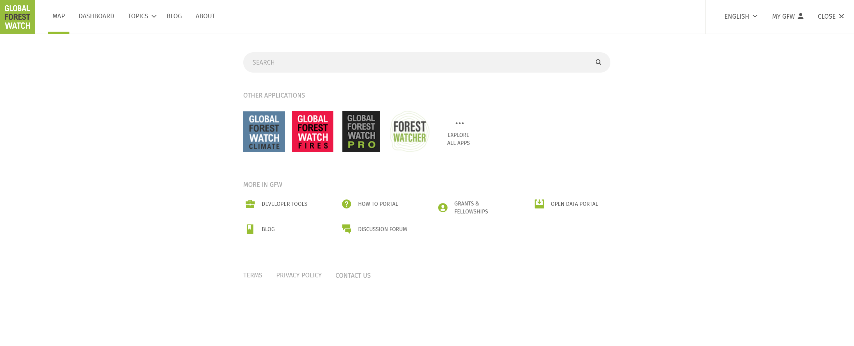

Slide 3
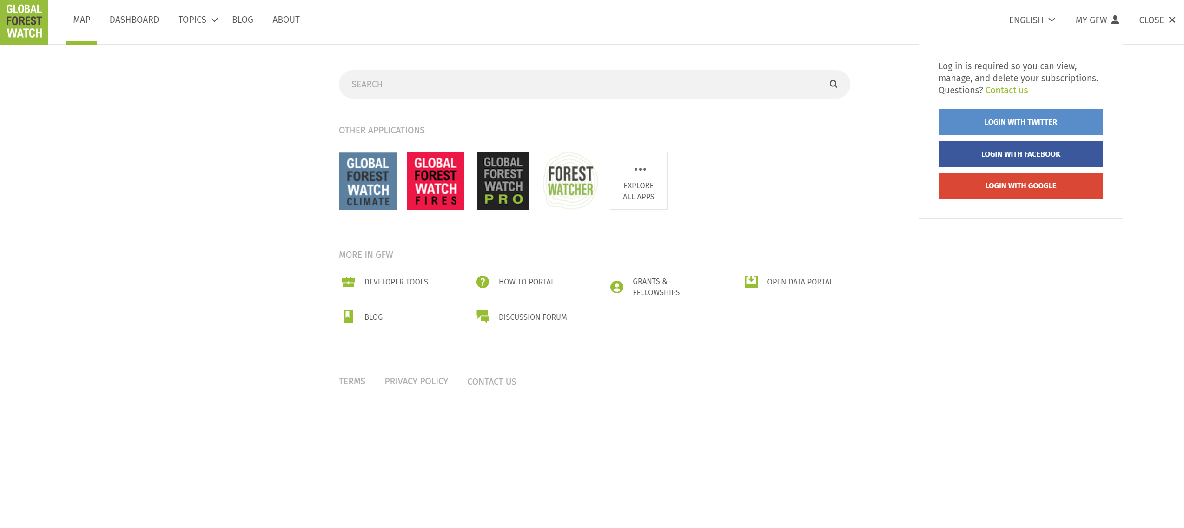

Slide 4
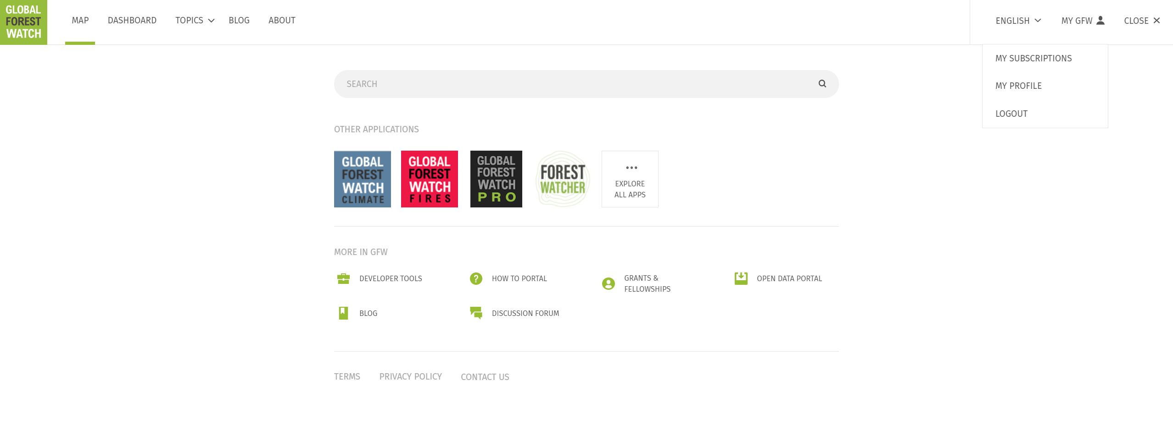

Slide 5
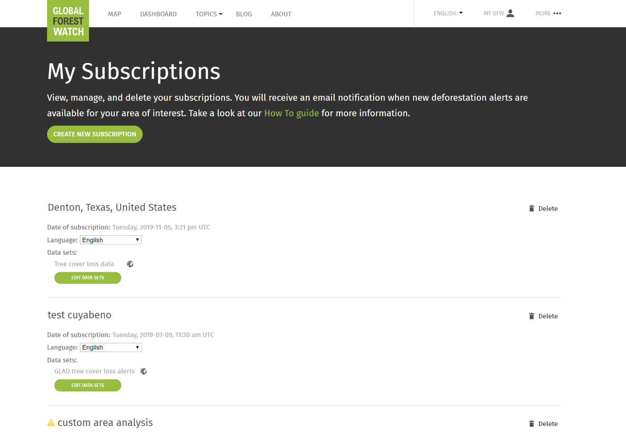

Slide 6
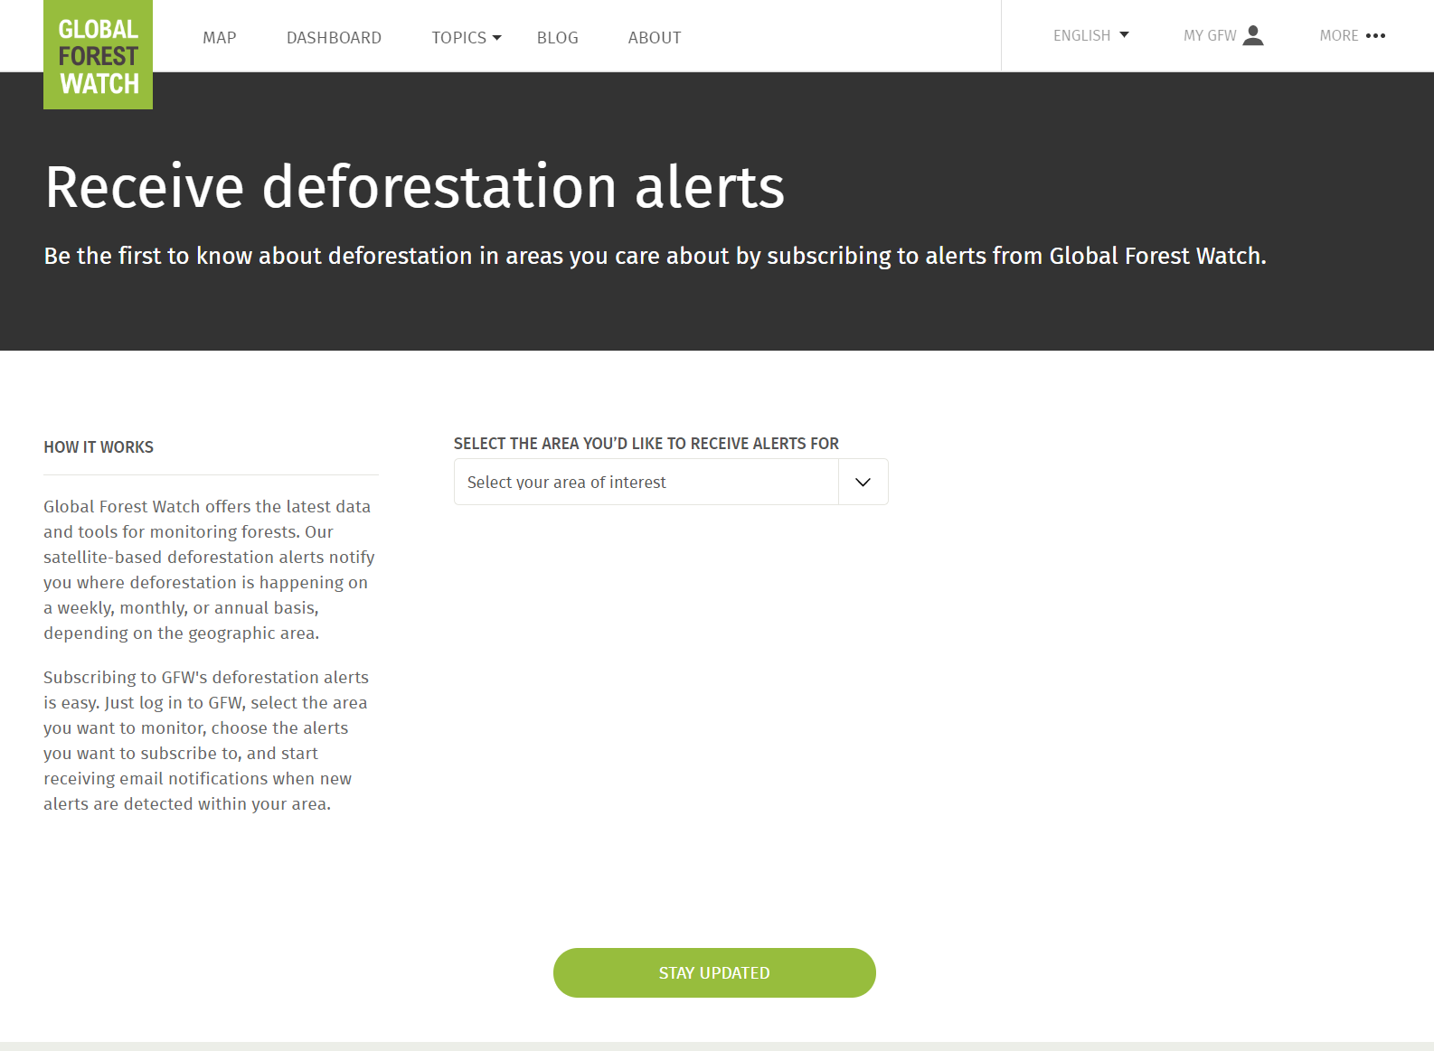

Slide 7
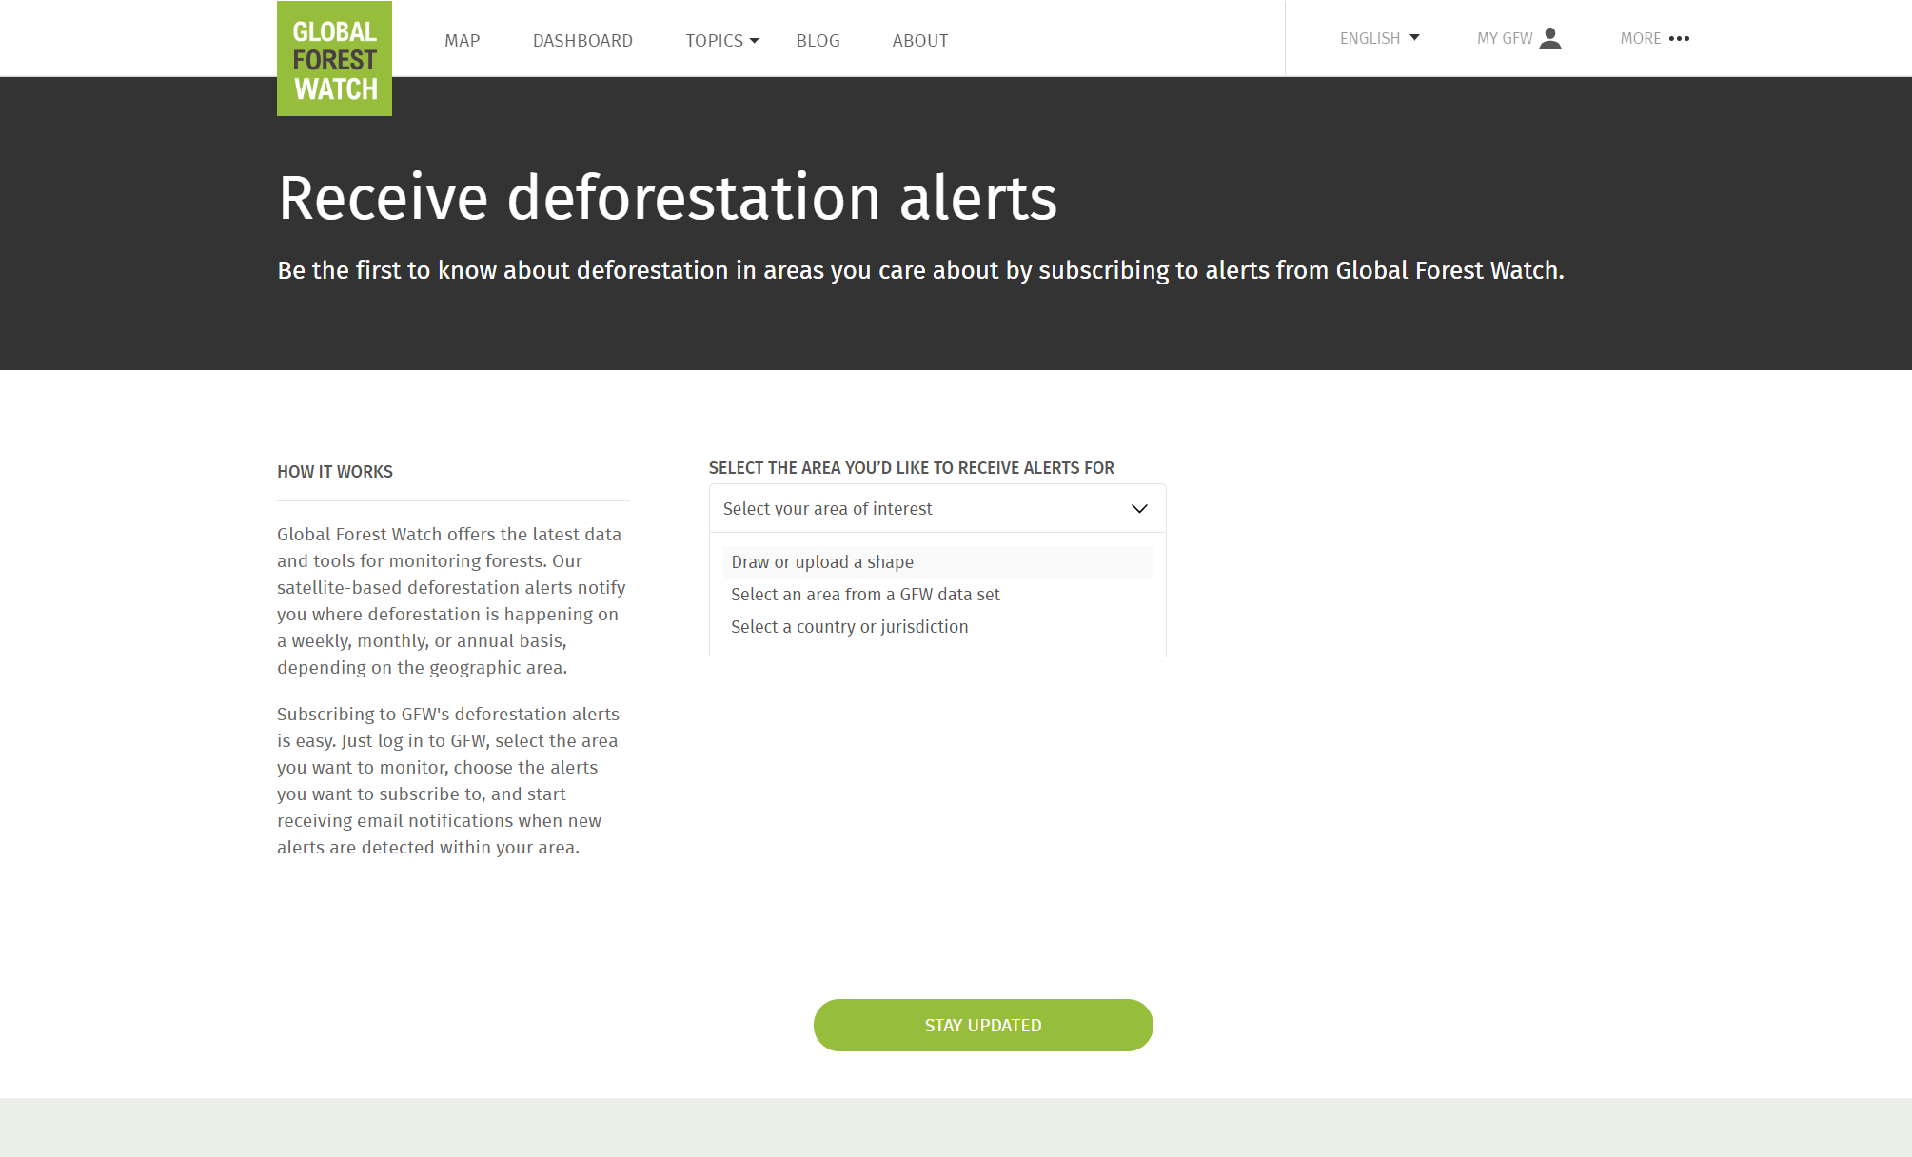

Slide 8
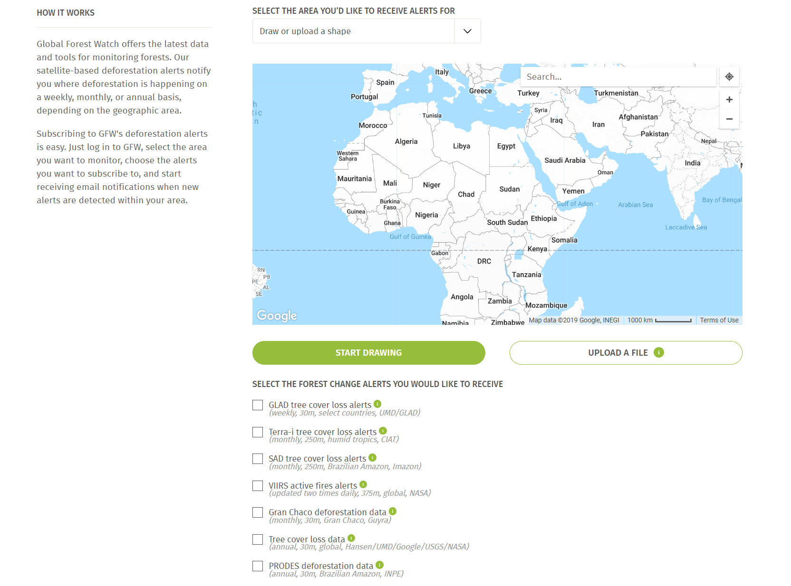

Slide 10
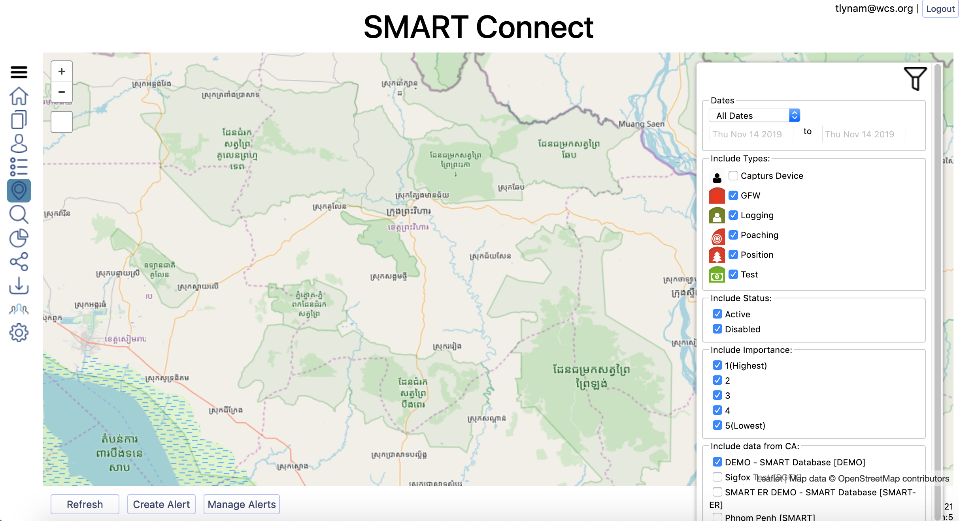

Slide 11
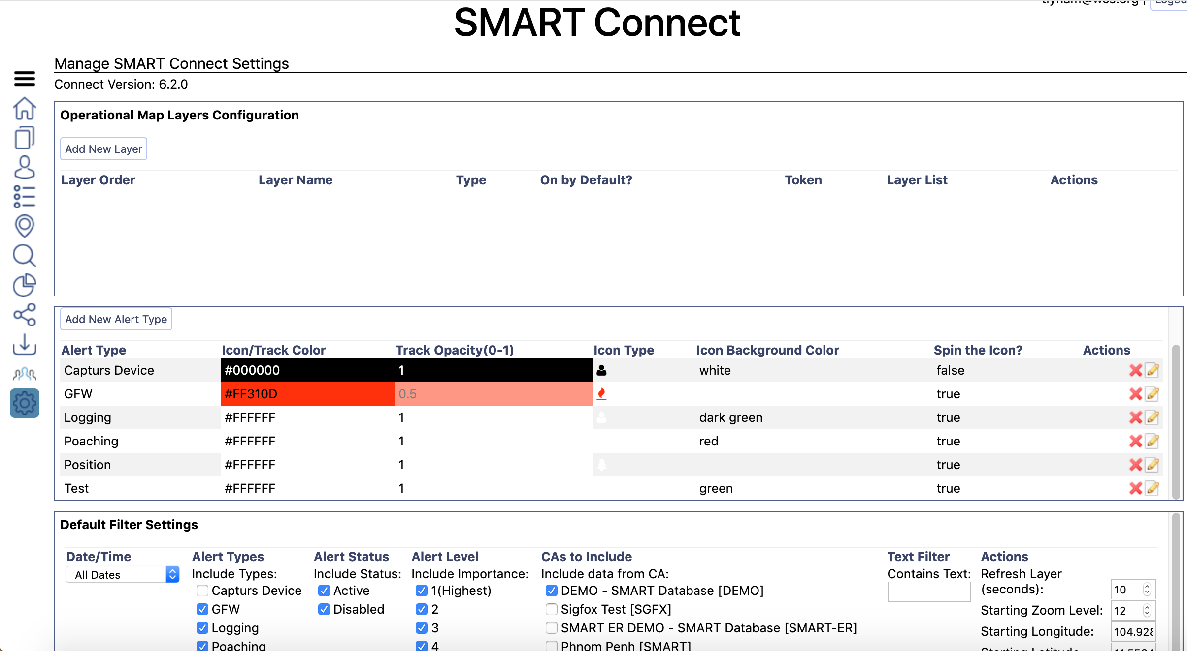

Slide 12
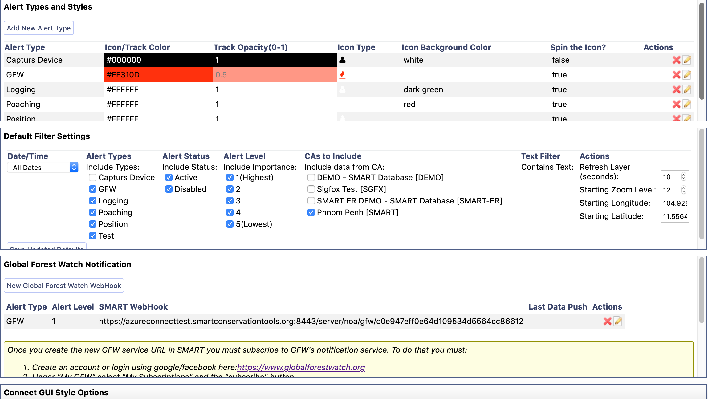

Slide 13
Copy created webhook from SMART Connect into the Webhook box

Slide 15
SMART – GLAD Desktop Connection
Insert the URL for your own Connect instance here

